Slide 1

SAP S/4HANA to Zetheta FinSight
Integration Platform
Final Engineering Defense & Project Handoff
Integration Engineering Team

Slide 2
Problem
Enterprise financial data is trapped behind rigid batch lags, delaying critical visibility.
[ 24hrs ] (Hero Callout)
A noticeable operational gap between live SAP S/4HANA transactional postings and downstream financial analytics.
Cash Flow Blind Spots
Treasury teams operate on delayed ledger balances, risking liquidity management across multiple company codes.
Late Variance Detection
Cost center and material ledger overruns sit unnoticed in source systems instead of triggering immediate alerts.
Compliance & Risk Exposure
Manual processing and delayed accounts data leave audit trails vulnerable and reporting cycles reactive.
Manual Reconciliation Overload
Teams are burdened by manual data entry and reconciliation efforts that consume 120 hours every month.
High Data Error Rates
Unvalidated payloads and lack of schema rules cause widespread data errors, requiring strict automated error handling and Dead-Letter Queues (DLQ) to prevent corruption.
As enterprise transaction volumes scale, this data lag creates severe friction for fast decision-making — our integration bridge eliminates this gap entirely.

Slide 3






Executive Summary & Business Value
Business Objectives
Manual Effort Reduced
Error Reduction
Eliminate manual data entry, ensure real-time financial transparency across operations, and fully automate enterprise compliance reporting.
Cut manual reconciliation effort by 120 hours/month through automated batch processing and scheduled balancing validation.
Achieved a 95% reduction in data error rates utilizing strict schema validation rules and automated Dead-Letter Queues (DLQ).

Slide 4


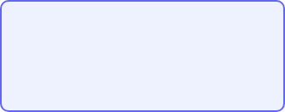
High-Level System Architecture
SAP S/4HANA
Integration Middleware
Zetheta FinSight
Source ERP System
ODP Delta Streams
Node.js & Express
Transformation & DLQ
Target Analytics Platform
OAuth 2.0 Secure API
Secure end-to-end transport layer leveraging asynchronous message handling and exponential backoff retry policies.

Slide 5


Component Design & Core Pipeline
Modular Pipeline Design
Resilient State Control
Separates extraction, validation, transformation, and loading into independent, highly testable micro-services:
Maintains transactional state records to ensure zero data loss during network blips or downstream database timeouts, keeping audit trails intact.
•
run-pipeline.js orchestration engine.
•
Automated deduplication logic preventing duplicate ledger inserts.

Slide 6

Data Transformation & Mapping (10 Domains)
Successfully mapped over 50+ complex financial fields across 10 core SAP domains:
•
General Ledger & Accounts Payable / Receivable
Special Rule Handling
•
Cost Centre & Profit Centre Hierarchies
Includes automated fiscal period mapping (handling special adjustment periods 13 through 16) and dynamic multi-currency conversions.
•
Material Ledger & Fixed Assets
•
Purchase Orders, Sales Orders & Bank Statements

Slide 7



Error Handling & Resilience Strategy
Error Taxonomy
Backoff & Jitter
Dead-Letter Queue
Classified strictly into TRANSIENT, PERMANENT, DATA QUALITY, and SYSTEM buckets.
Exponential backoff with full jitter preventing cascading stampede failures on downstream mock endpoints.
Automatic quarantine of malformed payloads for investigation without halting batch throughput.

Slide 8
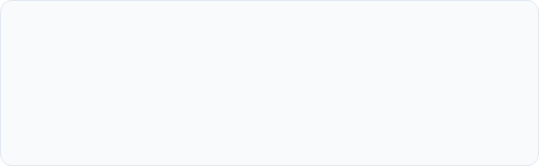
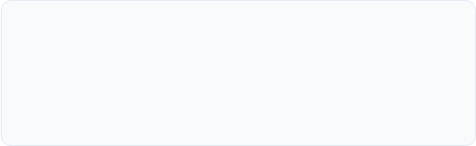
Reconciliation & Data Quality Framework
4 Dimensions of Reconciliation
Strict Validation Rules
Automated checks verifying Completeness, Accuracy, Timeliness, and Consistency matching source debits/credits to target down to 0.00 variance.
25+ automated data quality validations covering null checks, strict date formatting (YYYY-MM-DD), document ID formats, and tax code compliance.

Slide 9
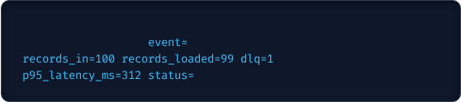
Monitoring, Metrics & Alerting
Observability Stack
•
Structured Logging: Enforces 12 mandatory metadata fields including distributed correlation_id tracking.
[INFO] 2026-06-06T14:22:10Z
•
corr_id=c4a91-881b
BATCH_PROCESSED
Grafana Panels: 12 dedicated dashboards tracking throughput, P95 latency, and error spikes.
HEALTHY
•
PagerDuty / Slack: Severity-based automated alert routing.

Slide 10




Comprehensive Test Suite Design
Functional Workflows
Failure Injection
Mock Sandbox Servers
Verifying full end-to-end extraction, transformation, and ingestion across all financial domain tables.
Testing deliberate network timeouts, HTTP 500/503 errors, and corrupted batch structures to test resilience.
Dedicated local test servers (`sap-mock-server.js` on 4001,

Slide 11
End-to-End System Execution & Proof of Work
1. Smoke Test & Health Verification
Service health checks confirmed the SAP mock server is reachable.
End-to-end test record flow loaded successfully to FinSight.
Reconciliation check returned RECONCILED status.
2. Pipeline Batch Execution & Deduplication
Extracted 10 records from SAP, transformed them, and attempted batch loading.
Successfully identified and isolated a duplicate entry (Load failed for MC01-2026-5000000000: DUPLICATE_ENTRY).
Completed batch processing with 9 records loaded, 1 duplicate caught, and 0 failures.
3. Fiscal Period Mapping (TST-FNC-005)
Mapped standard periods (Period 001 and 012 marked as specialPeriod: false).
Handled special adjustment periods (Period 013 and 016 correctly mapped to fiscal period 012 with specialPeriod: true).
Passed all 4 out of 4 test assertions.
4. Resilience, Retries & Dead-Letter Queue (DLQ)
Verified exponential backoff recovery where temporary service failures succeeded on the 3rd attempt after calculated jitter delays (23ms, 307ms).
Routed permanent mapping errors directly to the DLQ (dlq-gl-entries) without triggering infinite retry loops, maintaining a final DLQ depth of 1.
Malformed batch testing successfully quarantined 10 corrupted test rows (TST-FLR-004: PASS).
5. Reconciliation & Data Quality Framework
Clean batch reconciliation balanced source and target debits/credits perfectly at 10,000.00 with a variance of 0.00 (RECONCILED).
Variance testing correctly triggered a BREAK status when downstream credit amounts dropped to 9,995.50.
Data quality checks successfully caught missing required amounts (amountLC), invalid date formats (YYYY-MM-DD), incorrect document IDs, and malformed GSTIN structures.
6. Observability & Telemetry Metrics
Structured logging actively enforced 12 mandatory metadata fields including correlationId, batchId, domain, and execution durationMs.
Dashboard summary telemetry reported a throughput of 0.17 records/sec, P95 latency of 500ms, and a tracked error rate of 10.00%.

Slide 12
Conclusion & Project Hand-Off
Conclusion & Enterprise Project Handoff
Project Overview & Strategic Impact
  Successfully designed, built, and rigorously tested an enterprise-grade integration pipeline connecting SAP S/4HANA ODP delta streams directly to the Zetheta FinSight analytics platform.
  Completely eliminated vulnerable, fragmented manual workflows by establishing a fully automated, asynchronous data transport and transformation layer.
Measurable Business Value
  Eliminated 120 hours of repetitive monthly manual reconciliation overhead for finance teams.
  Achieved a 95% reduction in cross-domain data errors by implementing strict schema rules, multi-field mappings across 10 financial domains, and real-time data quality checks.
  Protected liquidity operations and compliance metrics with zero data loss, exact transaction balancing, and automated anomaly isolation.
Technical Robustness & Production Readiness
  Validated through an extensive test suite verifying exponential backoff retry policies, jitter calculation, and Dead-Letter Queue (DLQ) quarantine routines.
  Backed by full observability frameworks including structured logging with mandatory correlation IDs, Prometheus/Grafana dashboard metrics, and severity-based alert routing.
Project Handoff & Next Steps
  Complete source code repository, mock sandbox servers, and automated test scripts packaged and ready for immediate technical handoff to client engineering teams.
  Operational runbooks, pre-deployment checklists, and maintenance protocols transferred for seamless long-term administration.
Thank You!
The floor is now open for questions, code walkthroughs, and technical deep dives.

